Slide 1


CS3003: Logic / Declarative Programming

Slide 2
Append/3
append([1,2], [a,b], [1,2,a,b]).
append([1,2], [a,b], [1,a,b]).

Slide 3
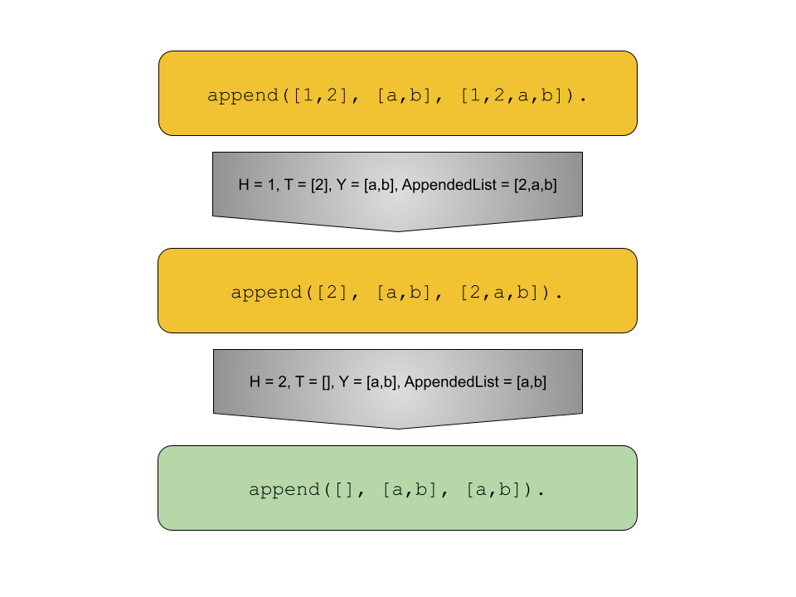
Append/3 - query success

Slide 4
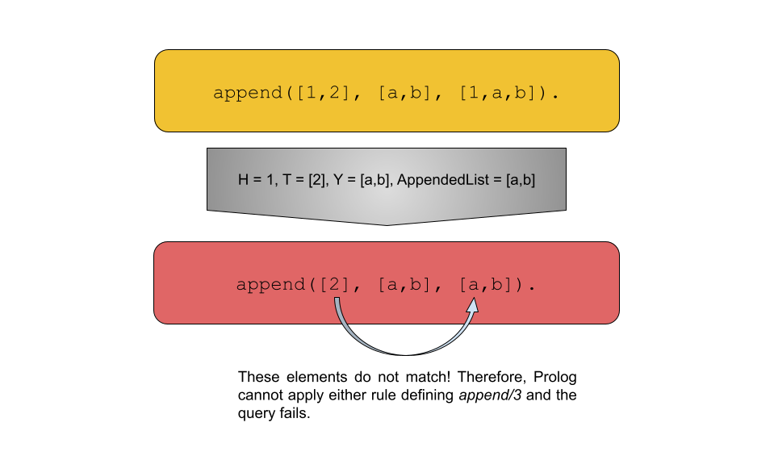
Append/3 - query failure

Slide 5
Prefix/2 and Suffix/2

Slide 6
Prefix/2 and Suffix/2
How about using the power of append?

Slide 7
Permute/2

Slide 8
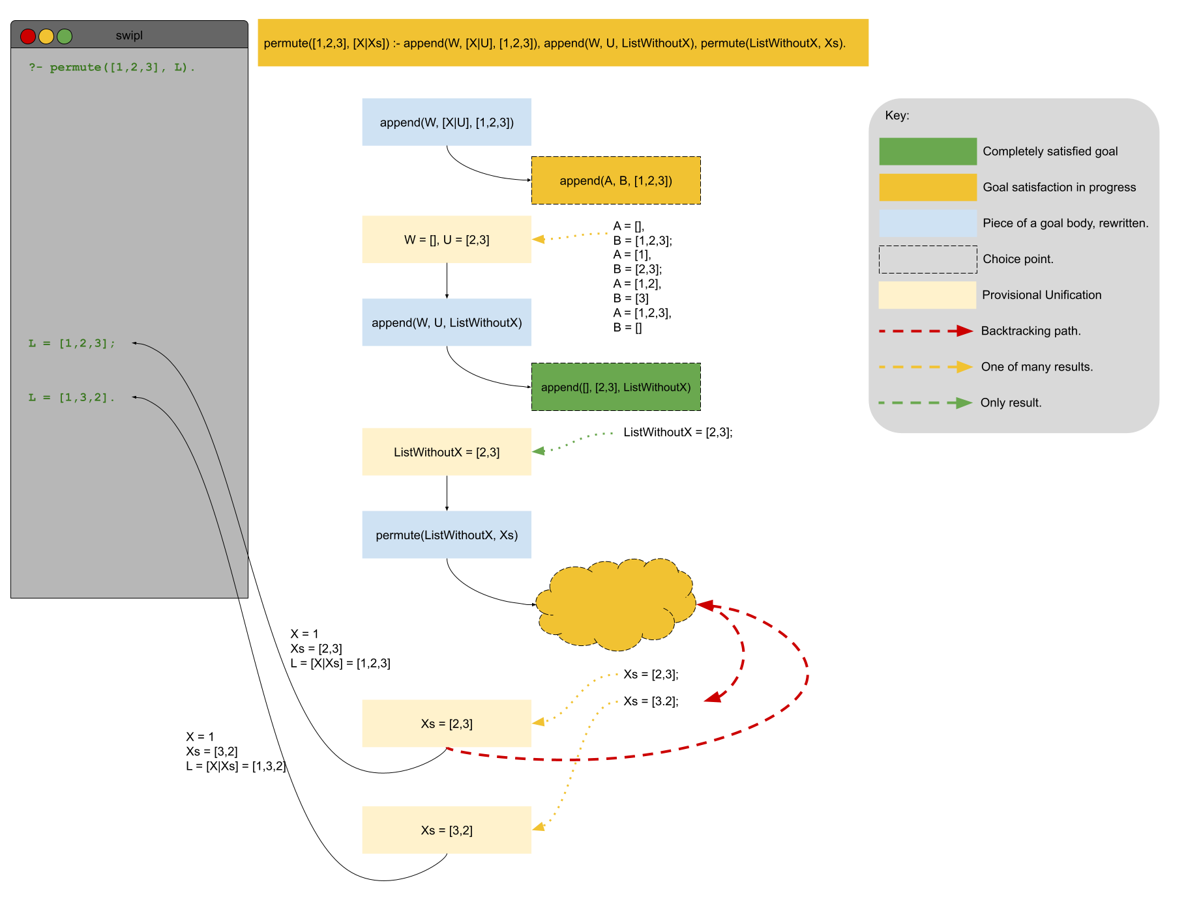
Permute/2

Slide 9
Merge/3
merge(Xs, [], Xs).
merge([], Ys, Ys).

Slide 10
Merge/3
merge([X|Xs], [Y|Ys], [X|Zs]) :- X<Y, merge(Xs, [Y|Ys], Zs).
merge([X|Xs], [Y|Ys], [X|Zs]) :- X=:=Y, merge(Xs, Ys, Zs).
merge([X|Xs], [Y|Ys], [Y|Zs]) :- Y<X, merge([X|Xs], Ys, Zs).

Slide 11
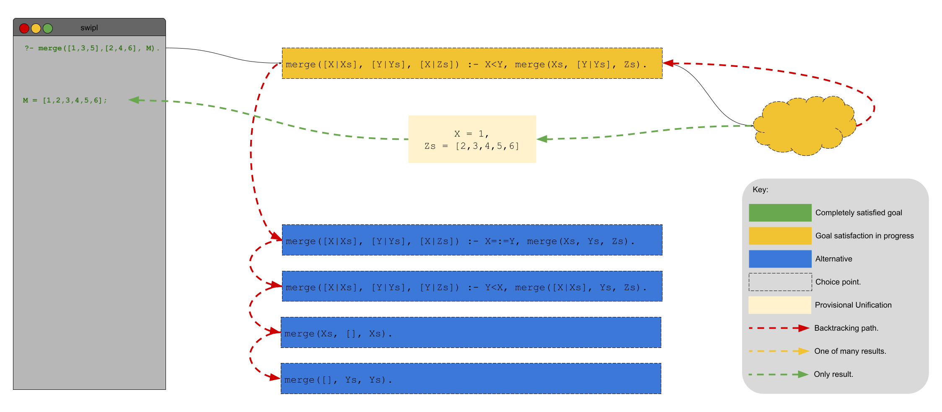
Merge/3

Slide 12
Merge/3 - cut
merge([X|Xs], [Y|Ys], [X|Zs]) :- X<Y, !, merge(Xs, [Y|Ys], Zs).
merge([X|Xs], [Y|Ys], [X|Zs]) :- X=:=Y, !, merge(Xs, Ys, Zs).
merge([X|Xs], [Y|Ys], [Y|Zs]) :- Y<X, !, merge([X|Xs], Ys, Zs).
merge(Xs, [], Xs) :- !.
merge([], Ys, Ys) :- !.

Slide 13
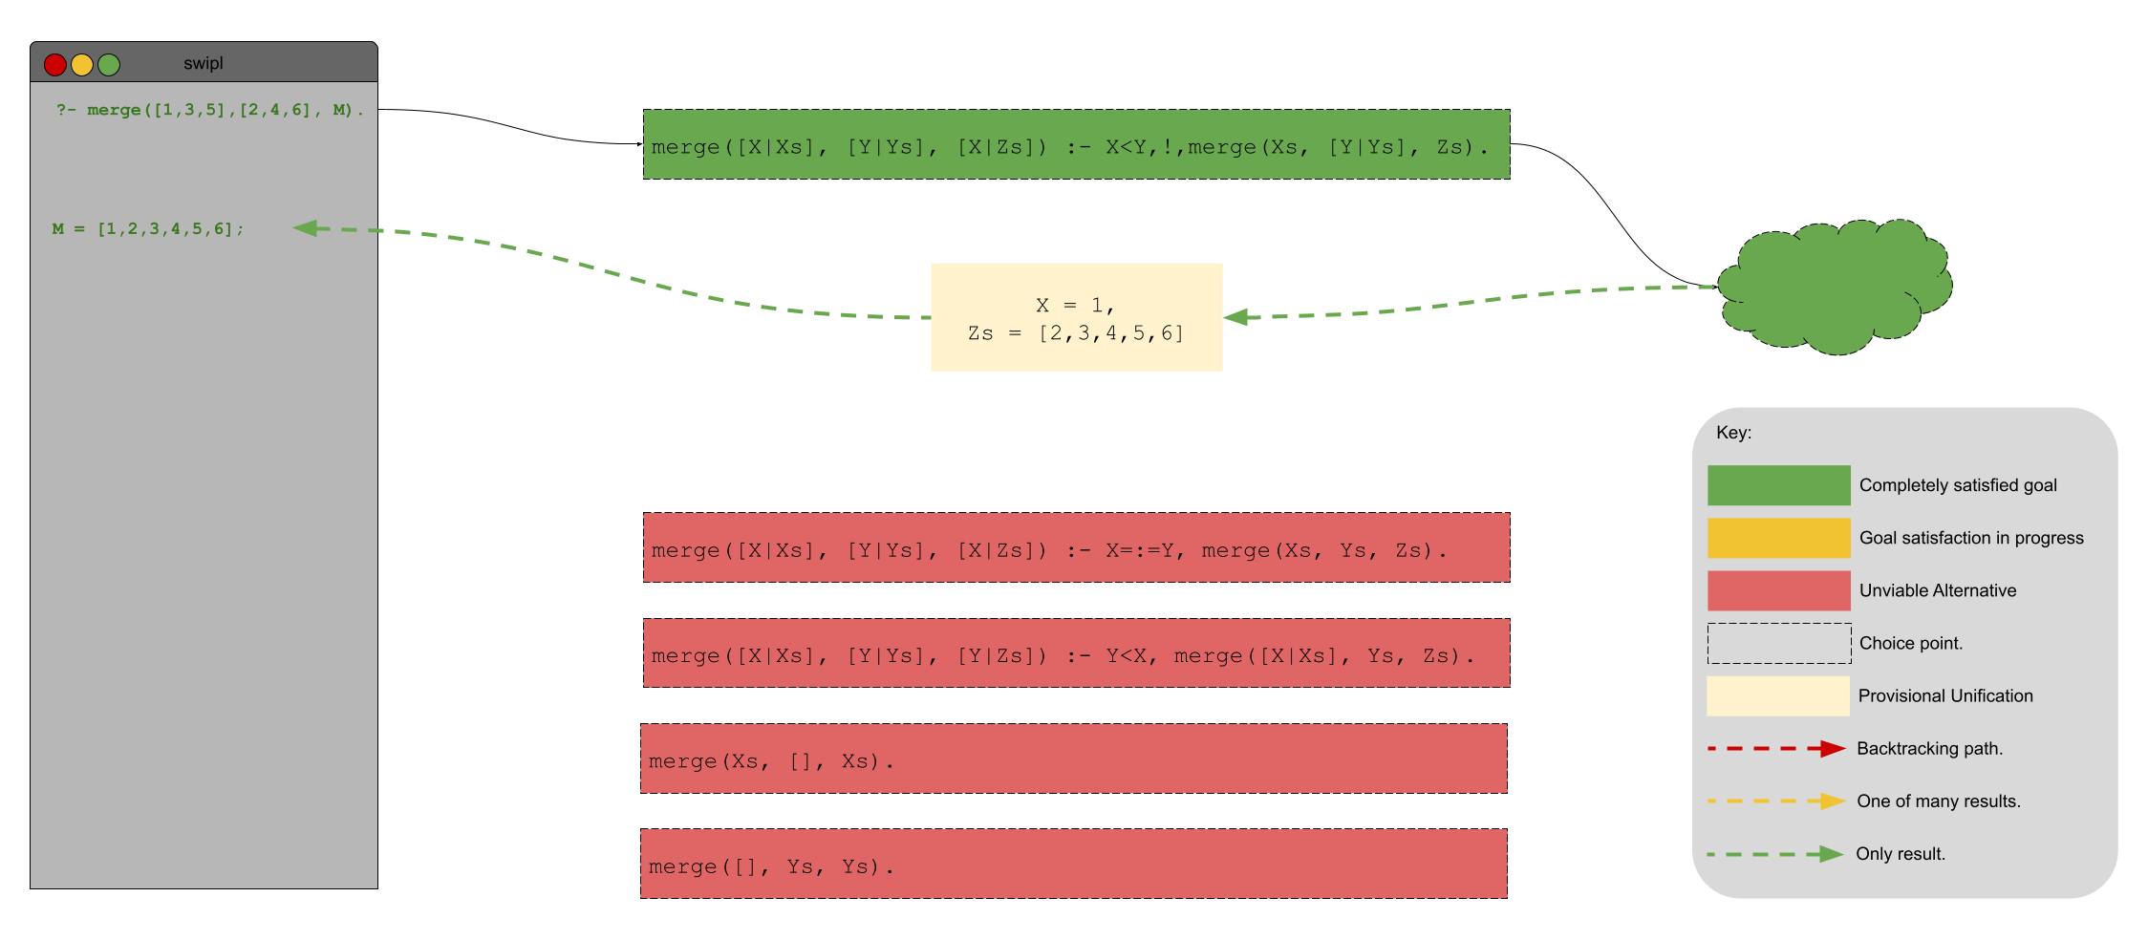
Merge/3 - cut

Slide 14
bsort/2
bsort(Unsorted, Sorted):-
append(Left, [A, B | Right], Unsorted),
B<A,
append(Left, [B, A | Right], MoreSorted),
bsort(MoreSorted, Sorted).
bsort(Sorted, Sorted).

Slide 15
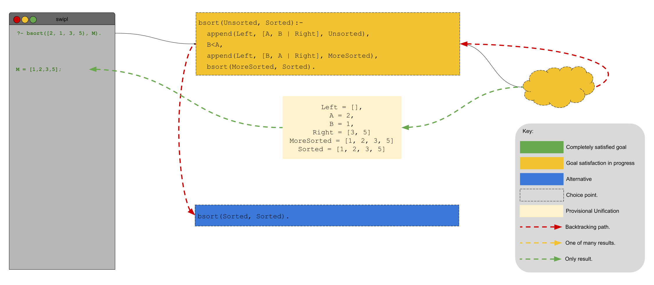
bsort/2

Slide 16
bsort/2 - cut
bsort(Unsorted, Sorted):-
append(Left, [A, B | Right], Unsorted),
B<A, !,
append(Left, [B, A | Right], MoreSorted),
bsort(MoreSorted, Sorted).
bsort(Sorted, Sorted).

Slide 17
Fundamentals
∀x (P(x) → Fan(x, bearcats))
∃y (P(y) ∧ Speaks(y, Russian))

